Slide 1
9420 – Count the leaves
Introduction to Programming (II)

Slide 2
Outline
Description
Design flow
Code

Slide 3
Description
Given a tree, count the number of leaves in this tree. Each node has unique integer identification (ID), but all IDs may not be consecutive.

Slide 4
Input
Sample input:
4
1 2
1 4
1 3
1 5
1
7
1 2
2 3
3 4
2 5
2 7
2 8
8 6
1
0
There are multiple test cases
First line:
An integer N
The following N lines:
Each line has 2 integer a, b
Indicating Node a is node b’s parent
The N+1th line:
An integer indicating the root node
The input is terminated by N = 0.

Slide 5
Output
Print the number of the leaves for each test case.
Sample output:
4
4
Hint: All leaves have no children!

Slide 6
Design flow
Use std::set
One set records all the nodes in the tree and one records all the parent nodes
The size difference of these two sets will be the answer

Slide 7
Design flow
Read parent and child from the input
Store the parent and child into set<int>
use set.insert(int)
Output the size difference
use set.size()

Slide 8
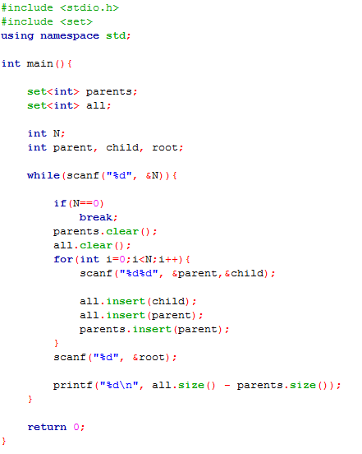
Code - declaration

Slide 9
Code

